Slide 1
NIFTY 50 OPTION TRADING STRATEGY
Table of Contents
Neutral Strategy – Iron Condor
Sell Side - Foundational Factors
Strategy Overview
Supporting Research & Data Analysis
Overview
Feature Selection & Engineering
Linear Regression Model
Limitations & Further Improvements
Risk Management & Adjustments
Minimizing Losing Days
Python Notebook – Link

Slide 2
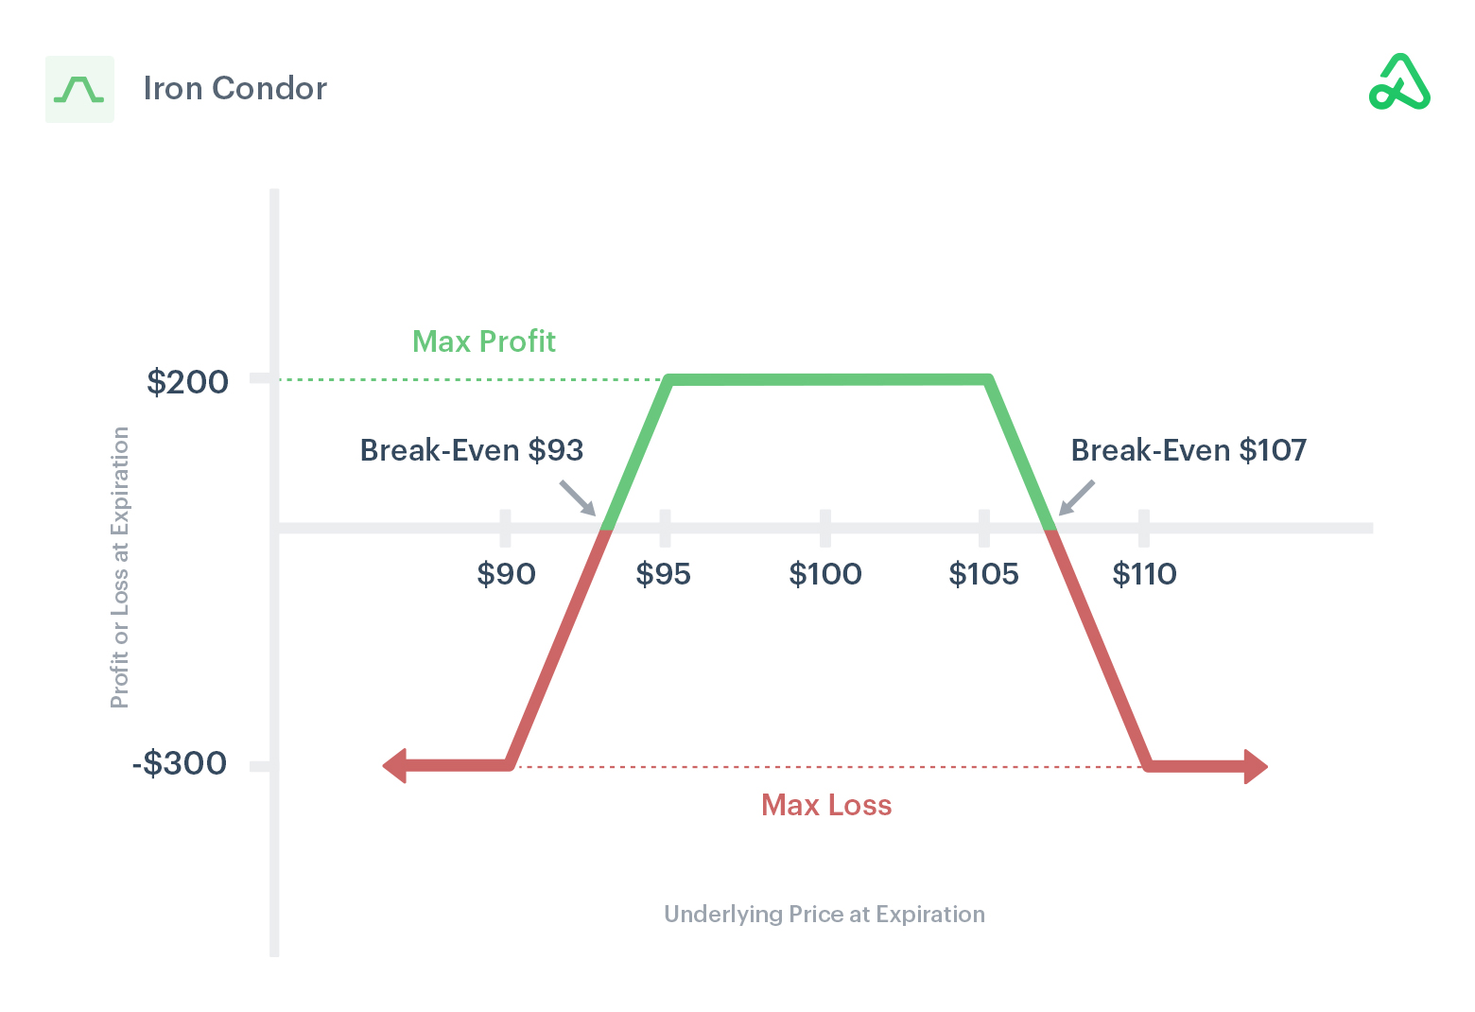

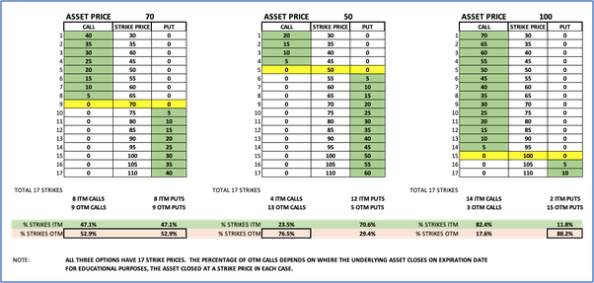
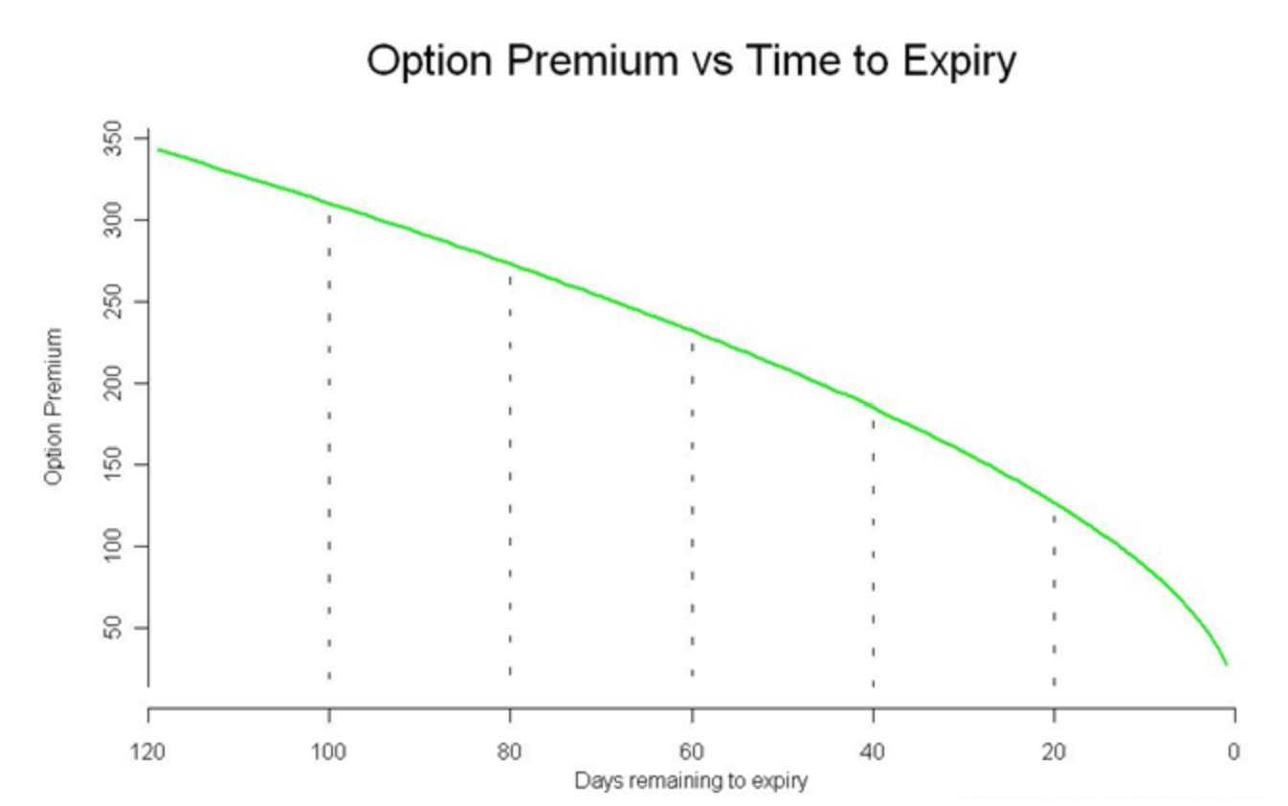
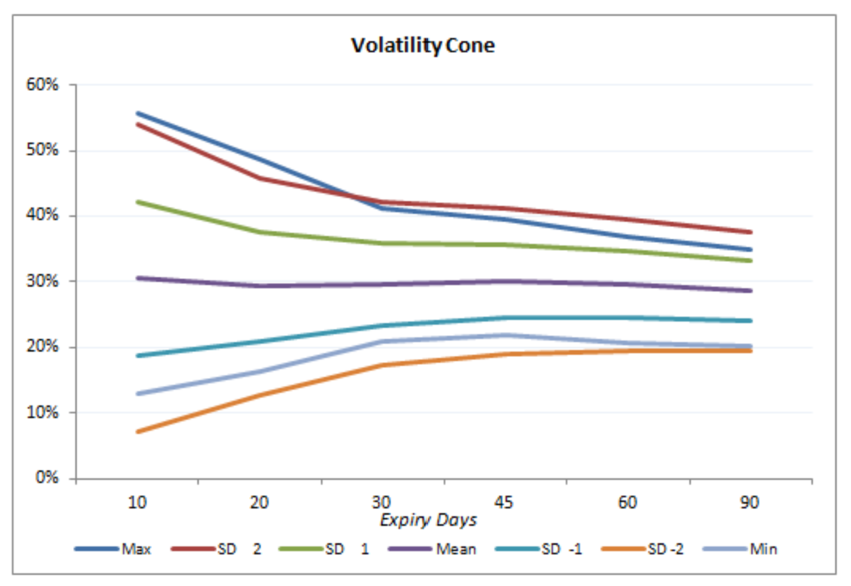
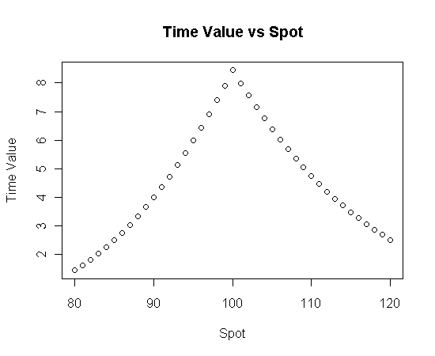
Neutral Strategy – Iron Condor
Sell Side - Foundational Factors
Factor - 1
Factor - 2
Theta Decay – Option Premium Decay faster closer to expiry. Our Goal is to capture this Decay
OTM Options– Deep Out of the money options expire worthless
Factor - 3
Factor - 4
Time value of options decrease as we move away from ATM option but the probability to expire worthless increases.
Volatility Cone - volatility of the options greatly affects the profitability. Higher volatility increases the likelihood of options expiring ITM

Slide 3
Strategy
4 Leg Delta Neutral Strategy
Sell OTM PUT and Sell OTM Call based of the low and high of range output by the linear regression model.
Hedge for Margin by buying even deeper OTM PUT and OTM call ‘X’ distance away from SELL Legs.
The calculation of 'X' is optimized to maximize profit by striking a balance between the profit gained from selling a larger quantity, considering the margin provided against the purchased options, and the potential loss on the buy side of those options.
To maintain the strategy's neutrality, adjustments are made in the opposite direction when the market moves. These adjustments are based on the newly determined range output.

Slide 4
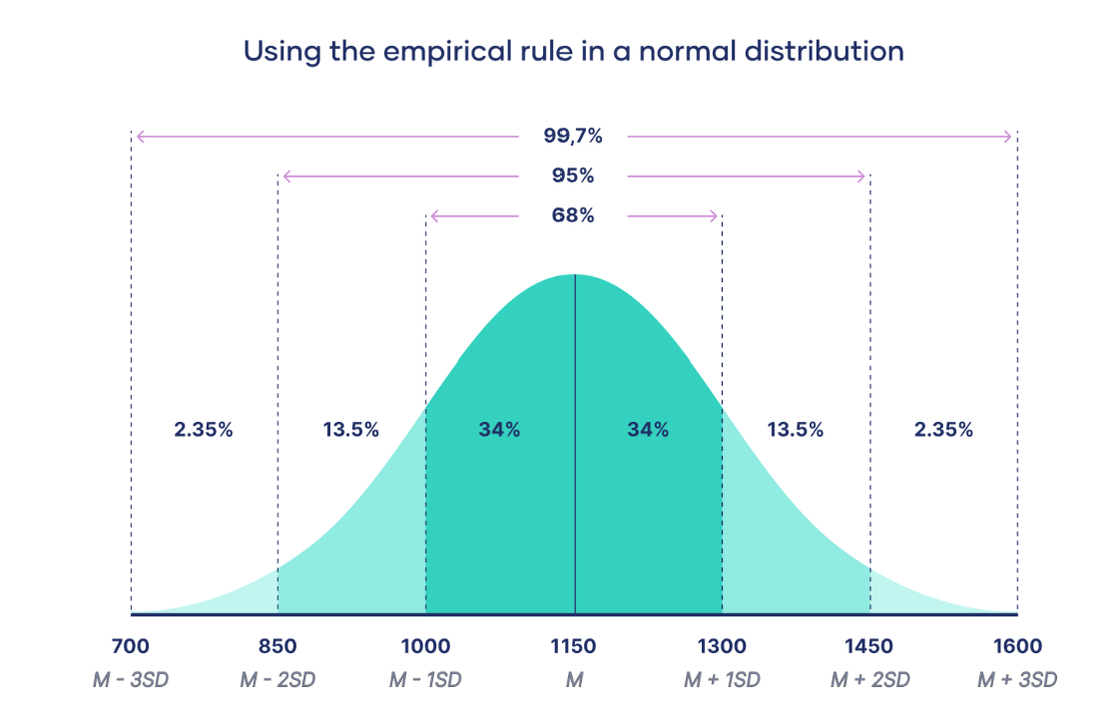
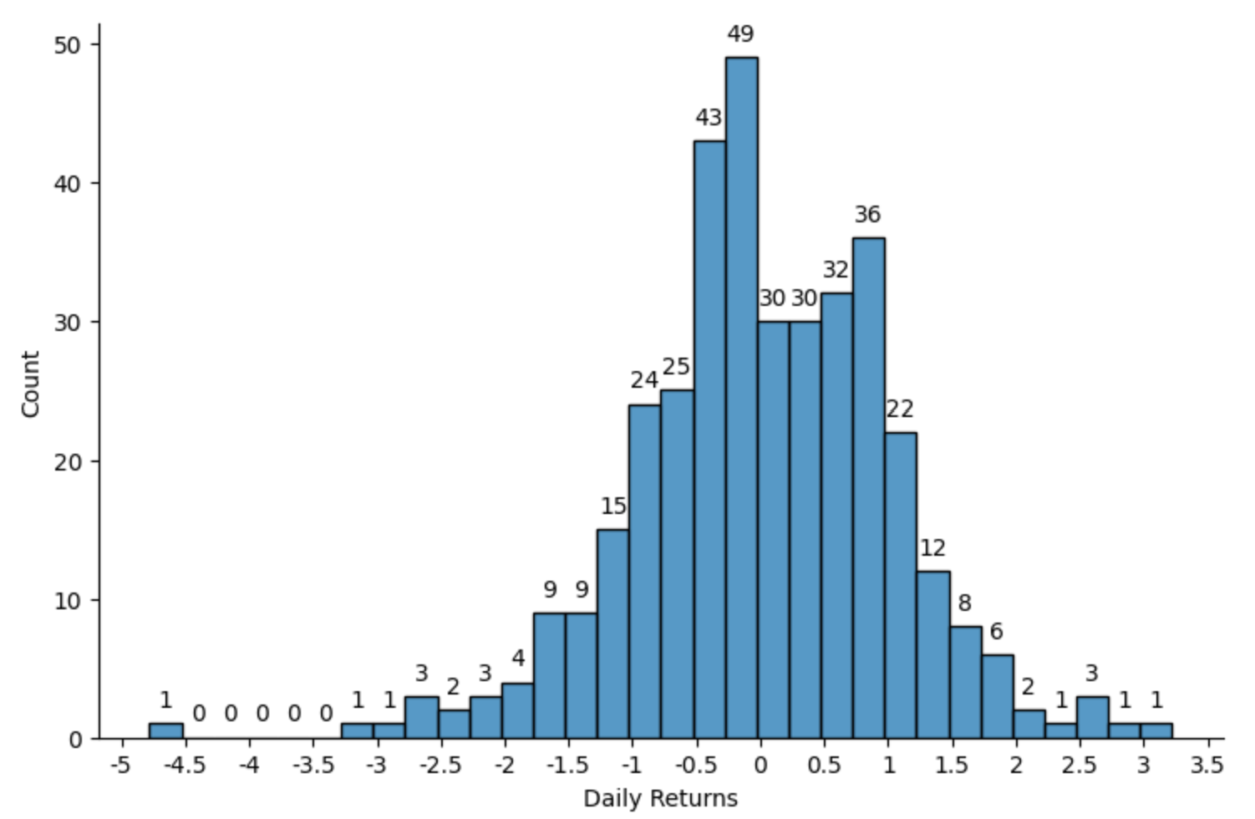
Supporting Research & Data Analysis
Naïve Approach
Our Model
X
Days to expiry
Vix
Linear Regression Model
Index daily returns doesn’t follow standard deviation.
Doesn’t consider Volatility.
If IV is high, then range should be big.
Doesn’t consider time to expiry.
If this time is high range should be big
If we assume daily returns of index follow normal distribution then we could pick strikes 1SD – 2 SD away with % of profitability between 68% - 95%
Y
Range Low
Range high
Python Notebook – Link

Slide 5
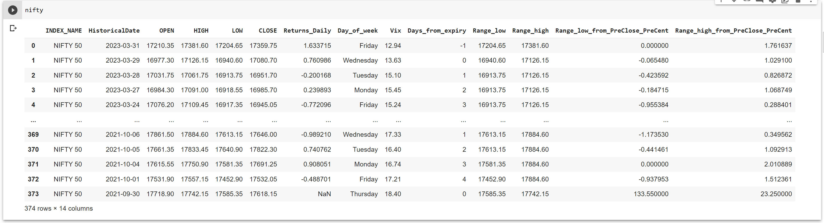


Calculations
Calculation of Range Low and Range High from Weekly expiry
Featurized Data Overview
Formula:
If Days from Expiry = 0:
RangeLow[Today] = Low
RangeHigh[Today] = High
Else:
RangeLow[Today] = Min(Low, RangeHigh[NextDay] )
RangeHigh[Today] = Max(High, RangeHigh[Next Day] )
Why:
Max
Max
Max
Max
Max
Why to use High and Low instead of Closing price
We are anyways profitable if closing price is between our Range.
Index Price
Min
Example
Min
Losses increase exponentially once it crosses our range and its not psychologically possible to hold such positions.
Min
Min
Min
4 3 2 1 0
Days from Expiry
Python Notebook – Link

Slide 6
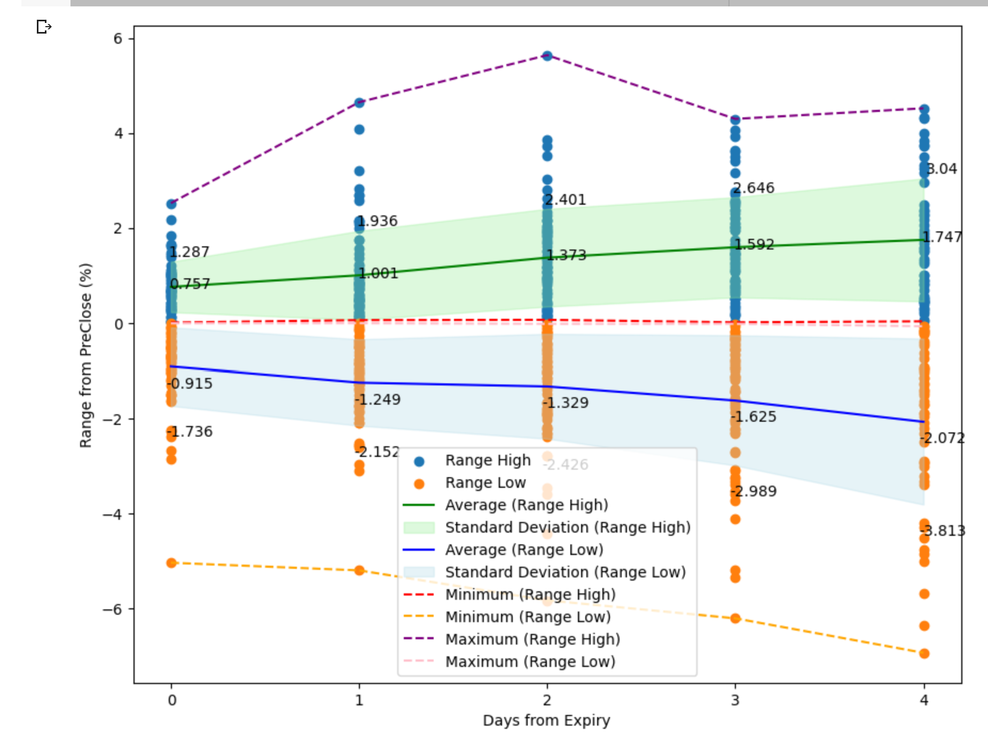

Calculations
Calculation of Range Low & High from previous close in % (Y)
X vs Y Scatter Plot
Formula:
RangeLow_from_PreClose[Today]
= min(0, RangeLow[Today] – Close[PreviousDay] ) in %
RangeHigh_from_PreClose[Today]
= max(0, RangeHigh[Today] – Close[PreviousDay] ) in %
Why:
During GapUp(GapDown) it is possible that RangeLow(RangeHigh) could be above(below) Previous Day closing which will be ITM region wrt to Previous Day.
For such points range low will be previous day close and Y(in %) will be 0
Range increase as we have more days to expiry.
Avg + SD (for RangeHigh for each X) give good approximation of RangeHigh that could be used for trading as most points fall in this region
Similarly, Avg - SD (for RangeLow for each X) can be used as Range Low
But we can add Vix to the model to improve it further
These 0 are favorable to us but we want the range during unfavorable times.
They will shift the model’s prediction close to 0 hence removing them from Data

Slide 7
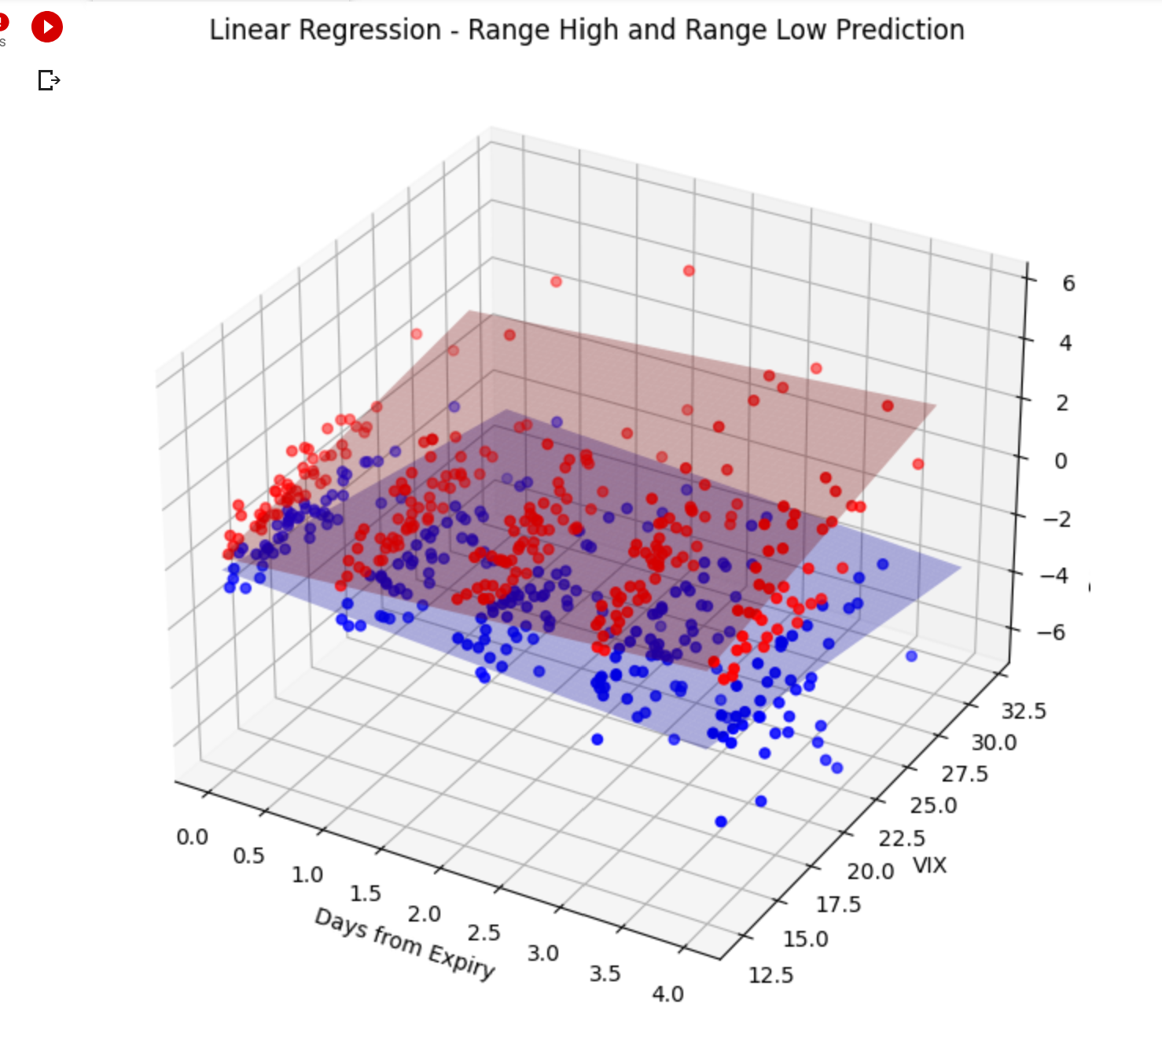

Linear Regression
Model
X vs Y Scatter Plot
Representation:
Model1 – Linear Regression of X1[‘Vix’, ‘Days to expiry’] to predict Y1 – RangeHigh from Previous Close in %
Model2 – Linear Regression of X2[‘Vix’, ‘Days to expiry’] to predict Y2 – RangeLow from Previous Close in %
Observations:
From Plot: As days from expiry increase, linear regression output moves away from 0 giving us bigger range.
Increase in volatility increases, model predict higher High and lower low.
Python Notebook – Link

Slide 8
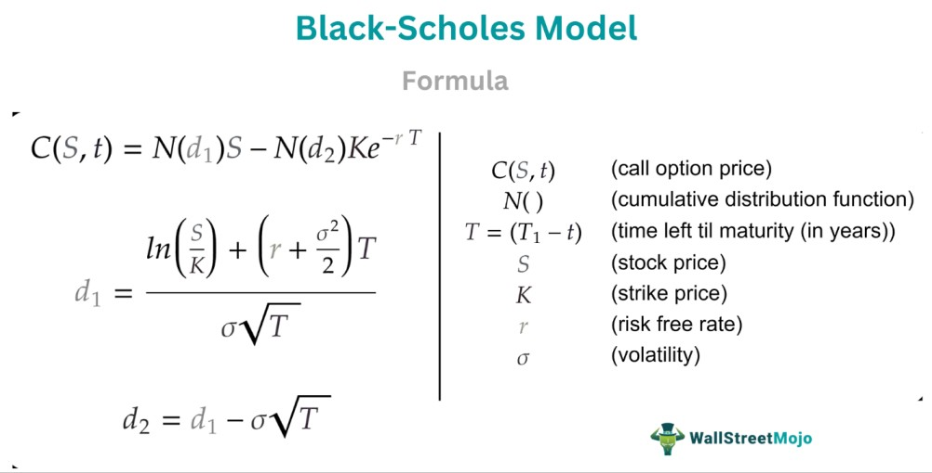
Model’s limitation and Improvements
Days to Expiry vs Y(Range High) Scatter Plot
Limitation
Better Prediction
The loss function of our model is squared loss which gives equal weightage to all data points.
But we know that delta ITM options > delta OTM options so change in option price is more if it crosses the range.
We want to penalize the points heavily if it is beyond our range.
Y
Actual Loss
Range High
Profit Lost
Possible Improvement: Custom loss function
Y’
Prediction Line
Basically, model is predicting the Stricke Price we should choose.
For Y (Actual) > Y’ (Predicted)
Loss = Actual Loss
= C( Y ,0 ,Y’ ) – C( Y’ ,t ,Y’ )
Else
Loss = Profit Lost
= C( Y ,t ,Y ) – C( Y ,t ,Y’ )
Days to expiry
Where:
C(Index price, time to expiry, Strike Price, Volatility = Vix)
C( Y ,0 ,Y’ ) = Option Price of Strike Y’ (on expiry) when index has moved to Y
C( Y’ ,t ,Y’ ) = Option Price of Strike Y’ (time t) when index is at Y’
C( Y ,t ,Y ) = Option price if Y is chosen and index at Y
C( Y ,t ,Y’ ) = Option price if Y’ is chosen and index at Y
Note: -I add an extra safety factor to the range predicted by model to reduce my losing days

Slide 9
Risk Management & Adjustment
Zone for Call
High Alert - Exit
Shifting Inward
Shifting Outward
Alert Zone
Safe Zone
When Market move in a direction adjust in opposite direction while maintaining the range.
Recalculate the range predicted by the models when time to expiry change and shift your strike price accordingly.
We define a safe zone which is 2/3 of range from one side.
When Market give sharp move and cross this zone, we enter into alert zone.
If we see a reversal, we stay (like in example when t = 3) else we shift positions away (t=2 we shifted).
Shift Away
Shift
Short CALL
Shift
Shift Away
Short CALL
Index Price
Shift
Index Price
Shift
Short PUT
Shift
Shift
4 3 2 1 0
Shift
Days from Expiry
Shift
Short PUT
Shift
4 3 2 1 0
Days from Expiry

Slide 10
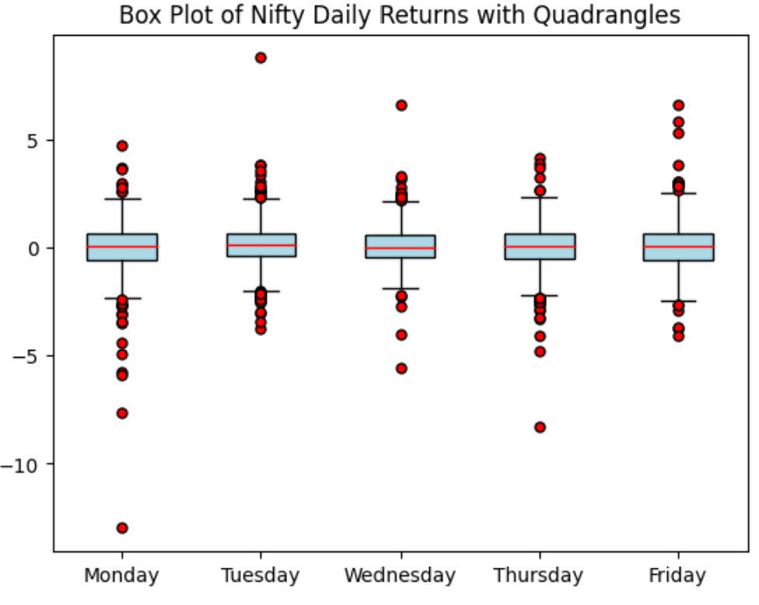
Minimizing Losing Days
Modification
Day of Week vs Daily Returns Whisker plot
Most of the Outliers lie on Monday and Friday.
So, Avoid Trading on Friday or short options with extra safety.
Initialize the trade on Monday after price movement has stabilized.
This gives a strong range to play with.
In Reality this has improved my returns from 68% in FY 21-22 to 140% in FY 22-23

